Slide 1

Project 1: Rice fintech bootcamp
Government impacts on Bitcoin vs Gold reserve value

Slide 2
Assets
bitcoin
gold
Government influence

Slide 3
Bitcoin vs Gold
Which is the safest place to put your money? Less risk?
Which is the best investment? Highest returns?
How has the government impacted the prices?

Slide 4
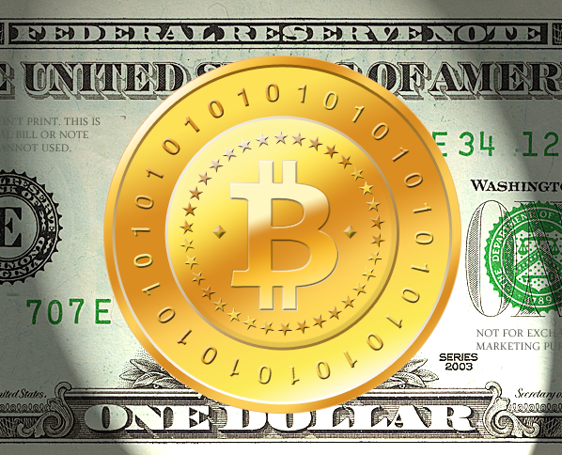
Bitcoin is a decentralized digital currency, without a central bank or single administrator, that can be sent from user to user on the peer-to-peer bitcoin network without the need for intermediaries
Bitcoin (BTC)
Bitcoin is posted about on social media every three seconds
Bitcoin increased in value by 66% between February 2021 and October 2021
46 million Americans have invested in Bitcoin
Bitcoin has a coin cap of 21 million

Slide 5

Gold coins are a common way of owning gold. Bullion coins are priced according to their fine weight, plus a small premium based on supply and demand
Gold
Compared to other precious metals used for investment, gold has been the most effective haven across several countries
Gold mining stocks (Royal Gold, Equinox Gold)

Slide 6
Asset Ownership
Facts
43% of people ages 18 to 29 say they have invested in, traded or used a cryptocurrency
30% of people ages 30-49 say they have invested in, traded or used a cryptocurrency
While central banks and other government-related agencies are the largest investors in gold, the majority of the of the precious metal gets transformed into jewelry each year. That industry uses an average of more than 2,000 tons of gold each year, or about $85 billion

Slide 7
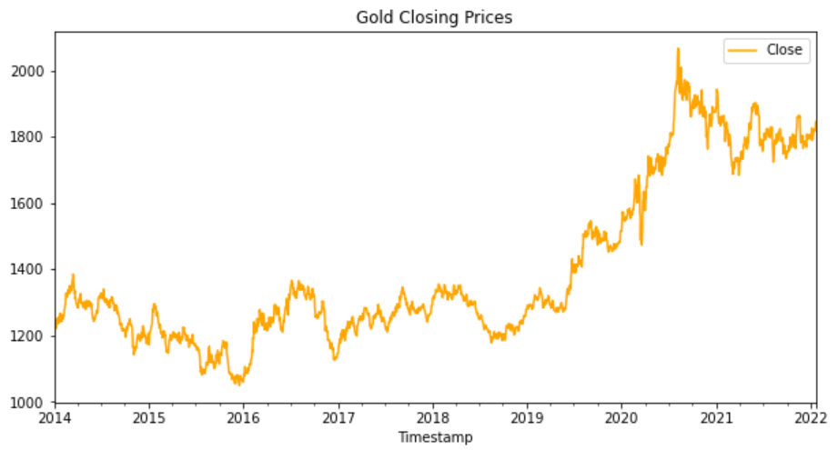
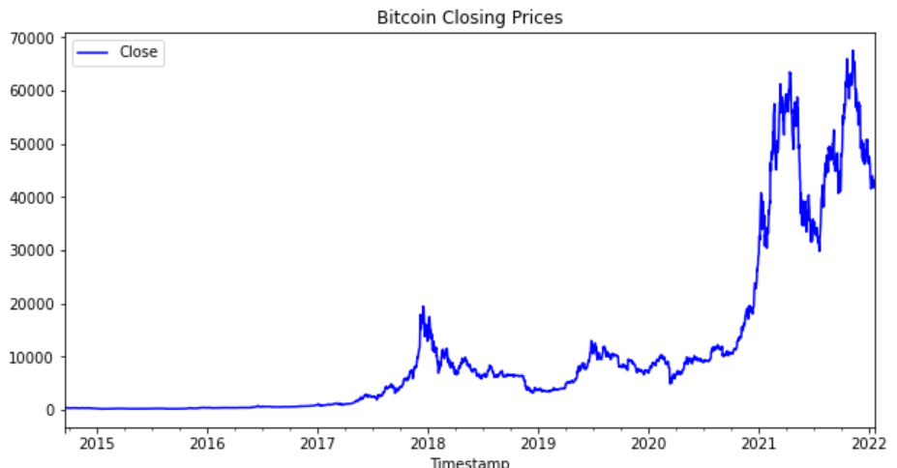
Risk

Slide 8

Government Influence

Slide 9
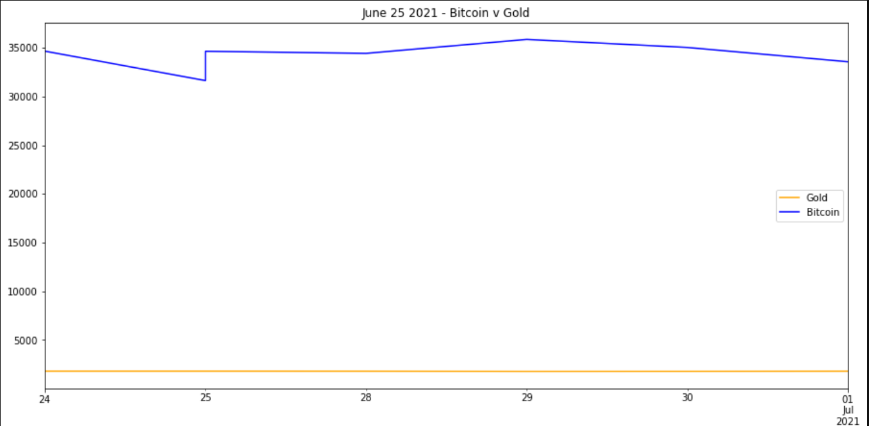
Government Influence
In 2021, President Joe Biden's infrastructure bill hurt the cryptocurrency price because it posed difficulties for decentralized exchanges, since they would have to provide tax information from clients that, by their nature, they do not collect. (June 25, 2021)
 | Bitcoin | Gold
June 24 | $34,675 | $1,784
June 25 | $31,943 | $1,786
June 26 | $32,023 | $1,786

Slide 10
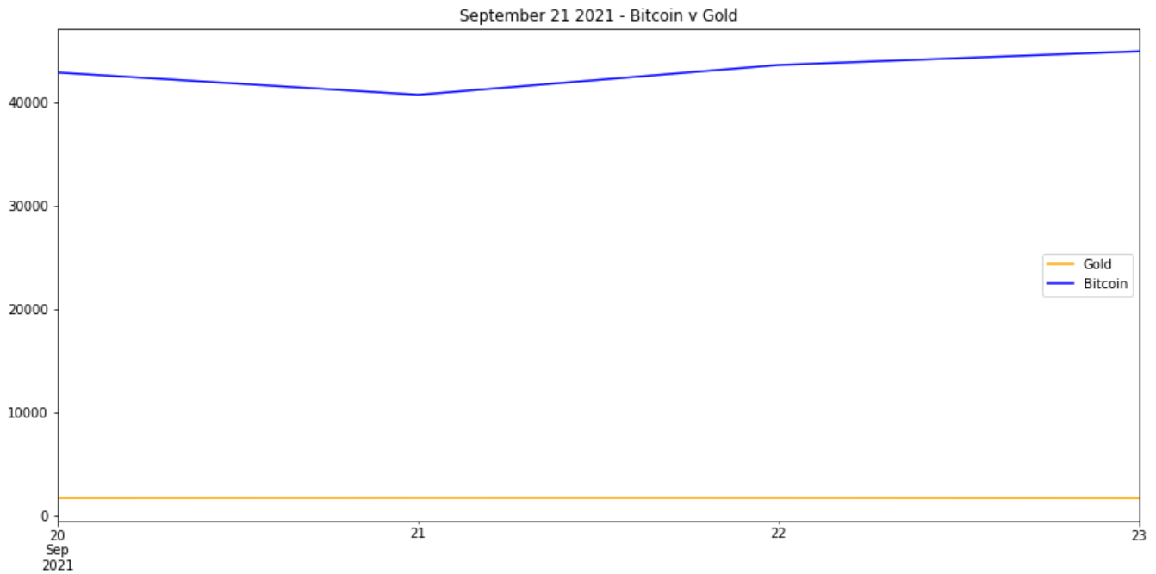
Government Influence
Bitcoin has also reacted to other market crises. For example, the cryptocurrency fell 6.9% at the end of 2021 as traders feared that Evergreen, the Chinese real estate giant, was about to collapse. Experts have called Evergreen’s struggles a major test for Beijing, with some worry the company risks becoming China’s “Lehman Brothers.” (Sept 21, 2021)
 | Bitcoin | Gold
Sept 20 | $42,932 | $1,757
Sept 21 | $40,386 | $1,774
Sept 22 | $43,587 | $1,773

Slide 11
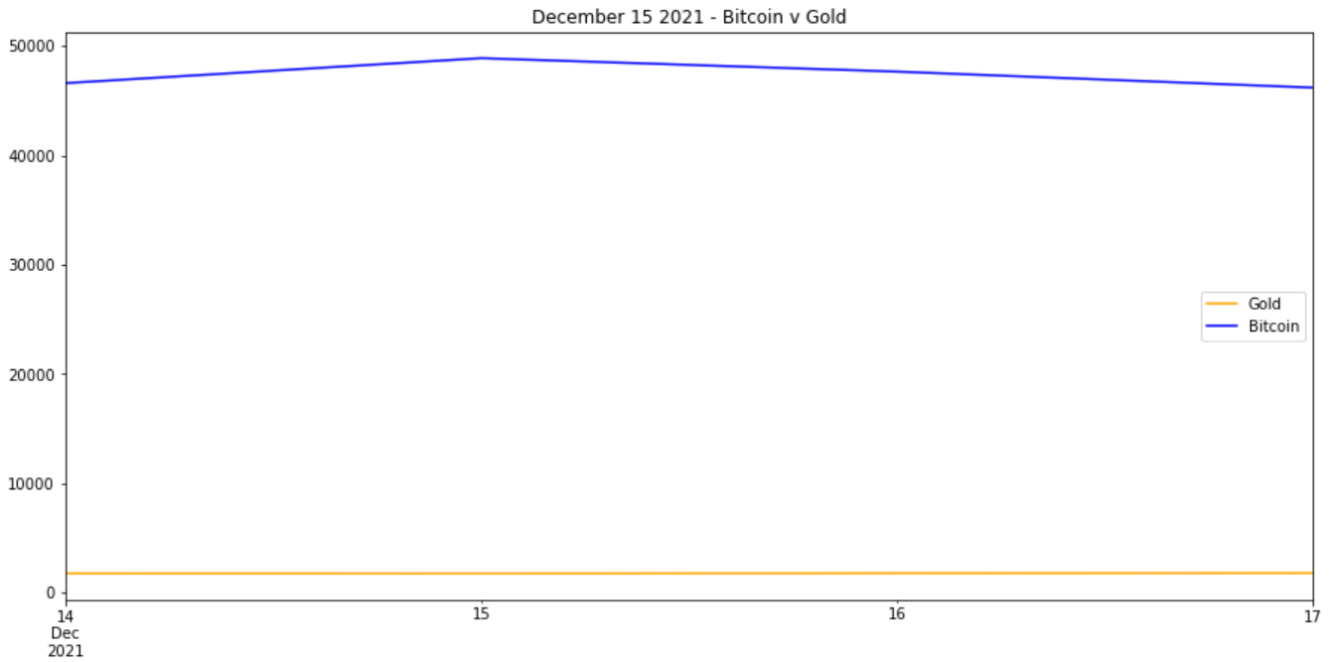
Government Influence
The US Federal Reserve forecasts interest rate hikes in 2022 (Dec 15, 2021)
 | Bitcoin | Gold
Dec 14 | $48,410 | $1,776
Dec 15 | $48,936 | $1,768
Dec 16 | $47,694 | $1,795

Slide 12
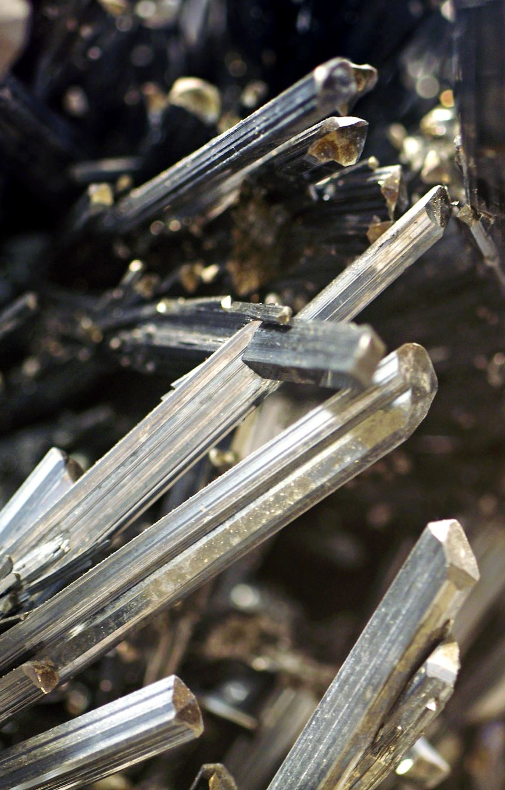
What is the safest way to care of our money?
Amid economic uncertainties, precious metals such as gold can prove to be a good hedge for a diversified portfolio.

